Slide 1

VpK
Visual parsed Kubernetes

Slide 2



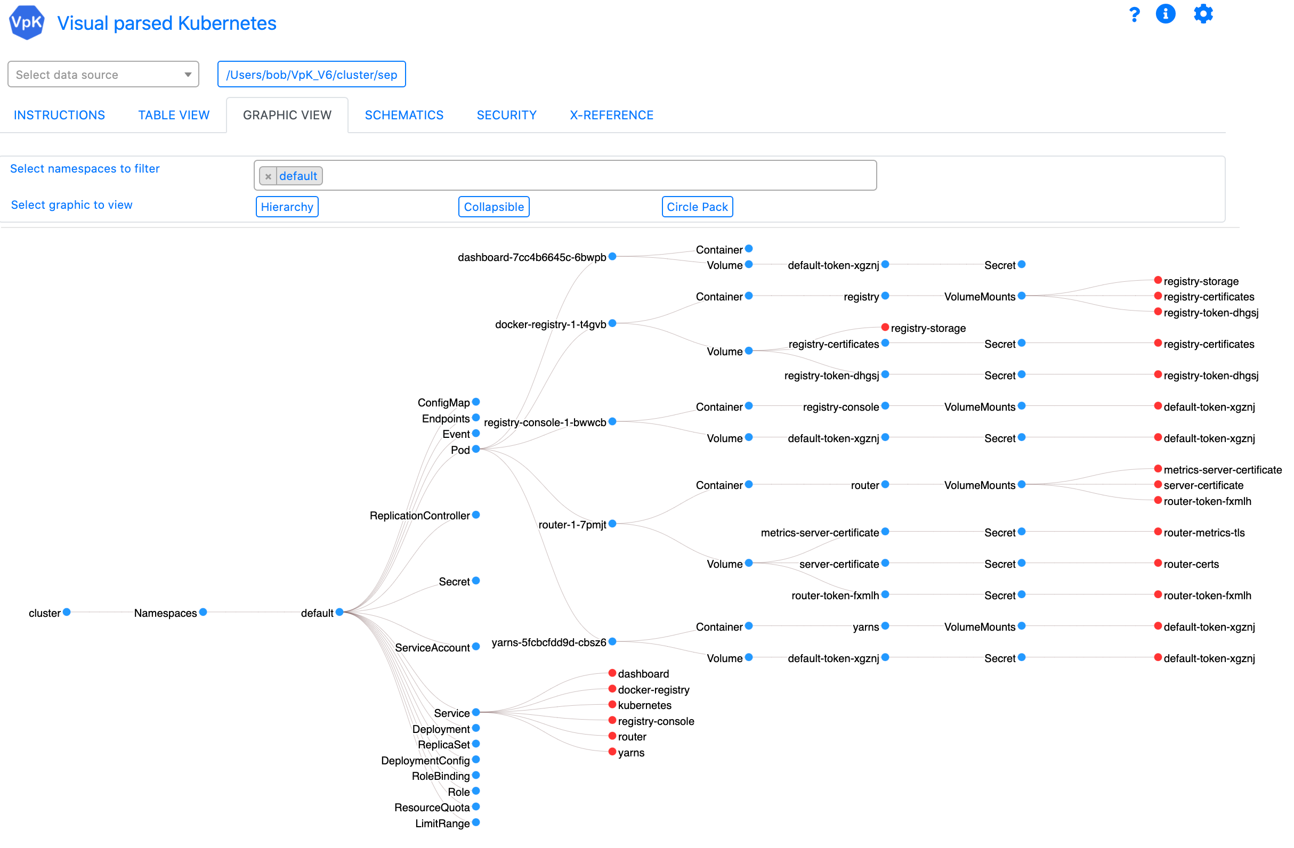
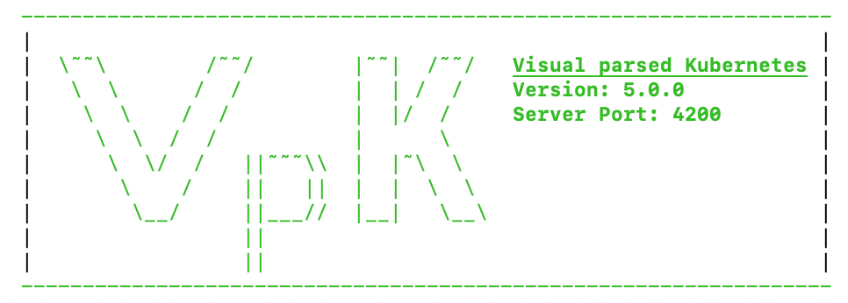

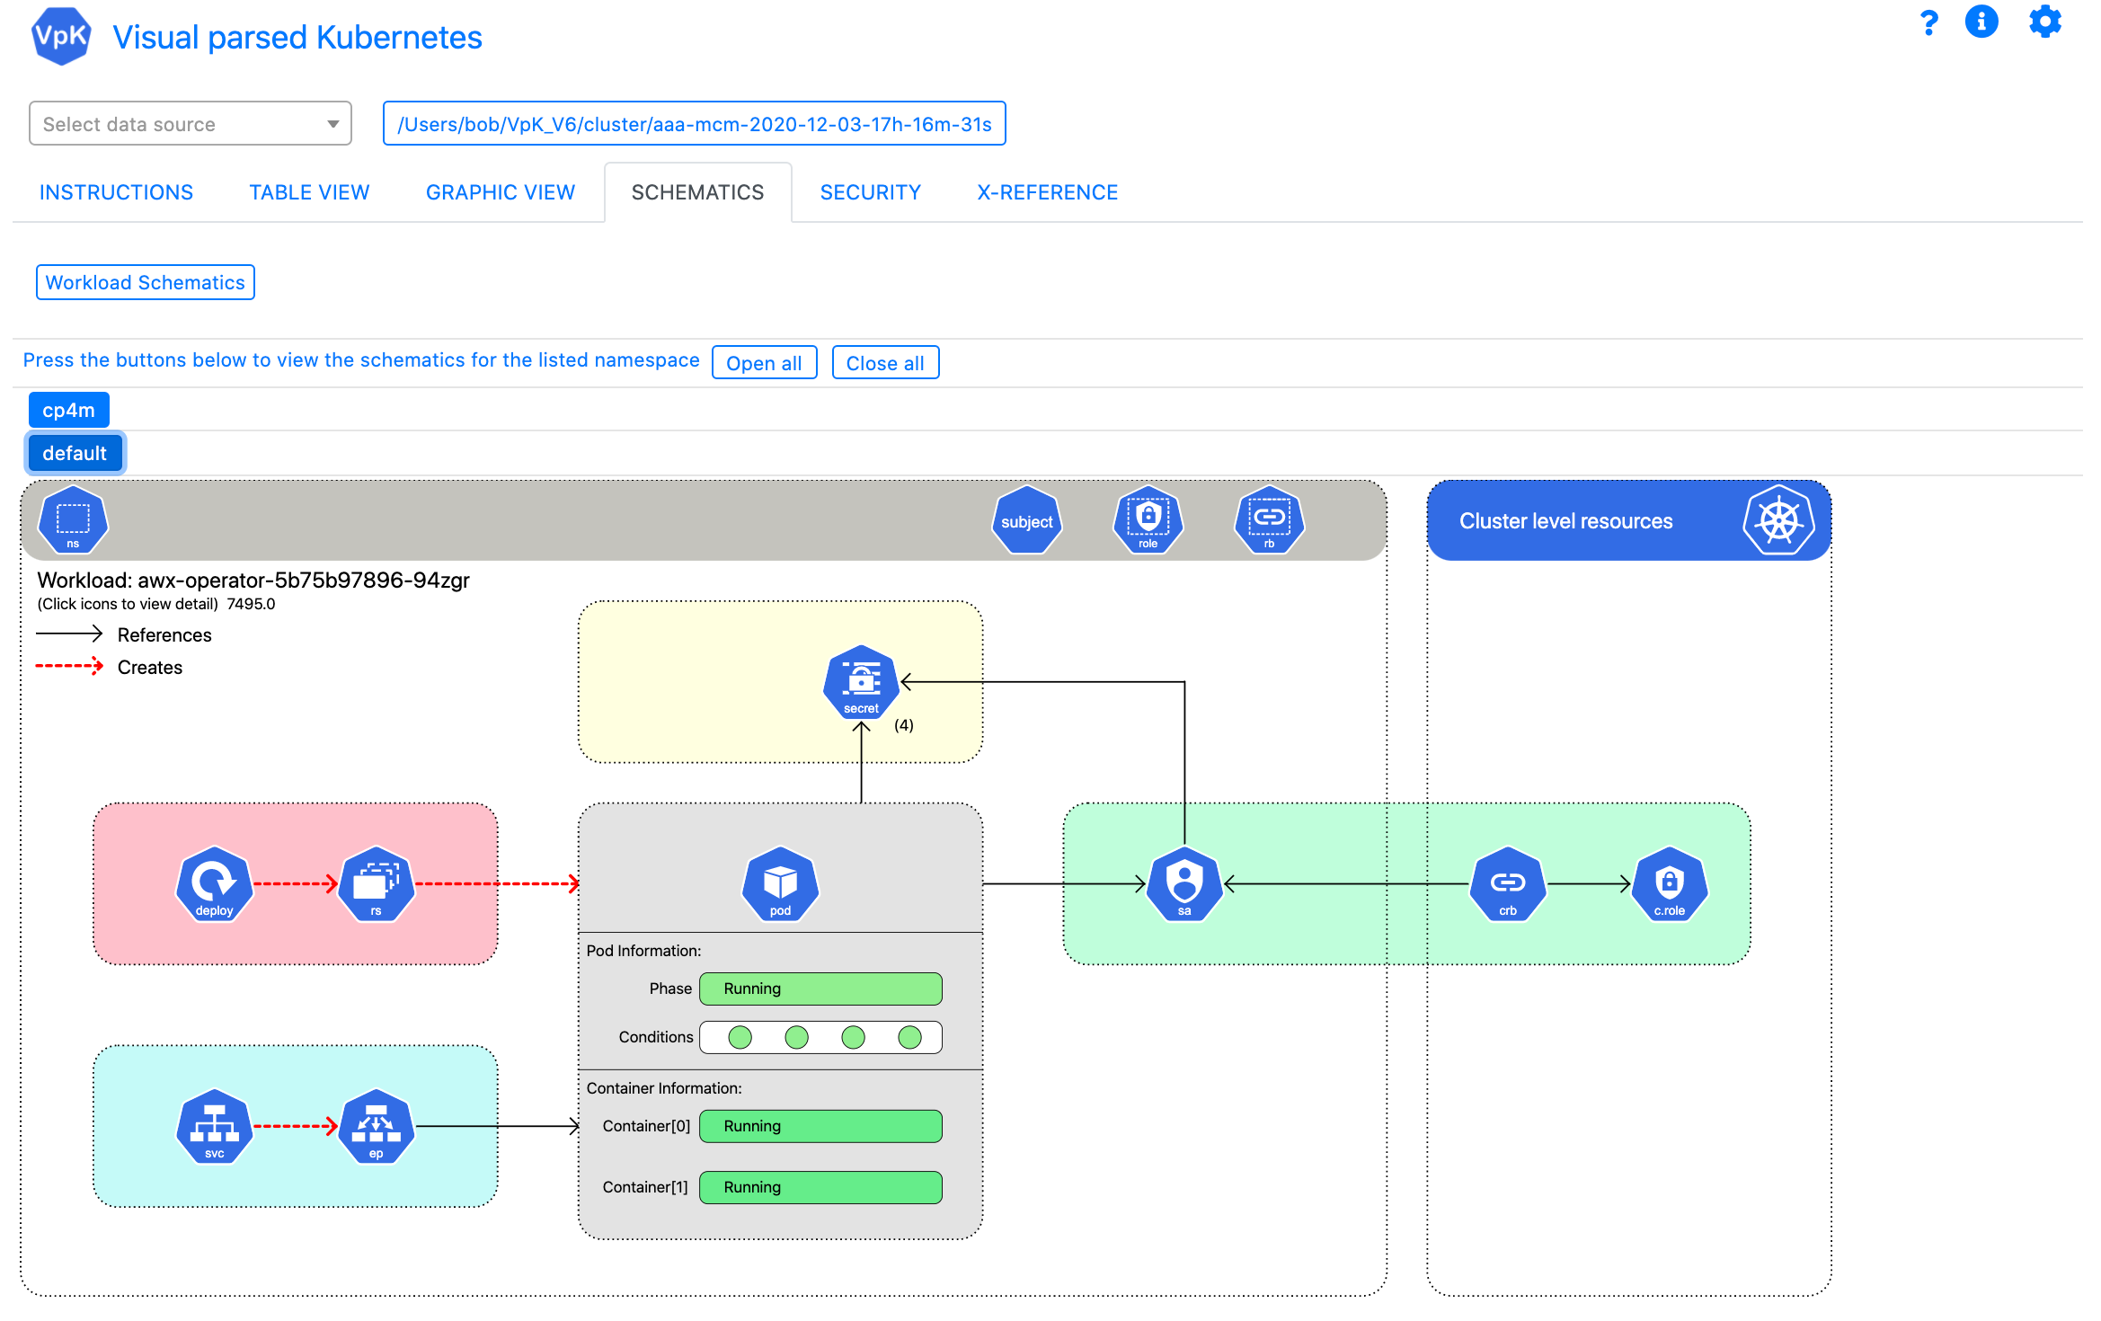
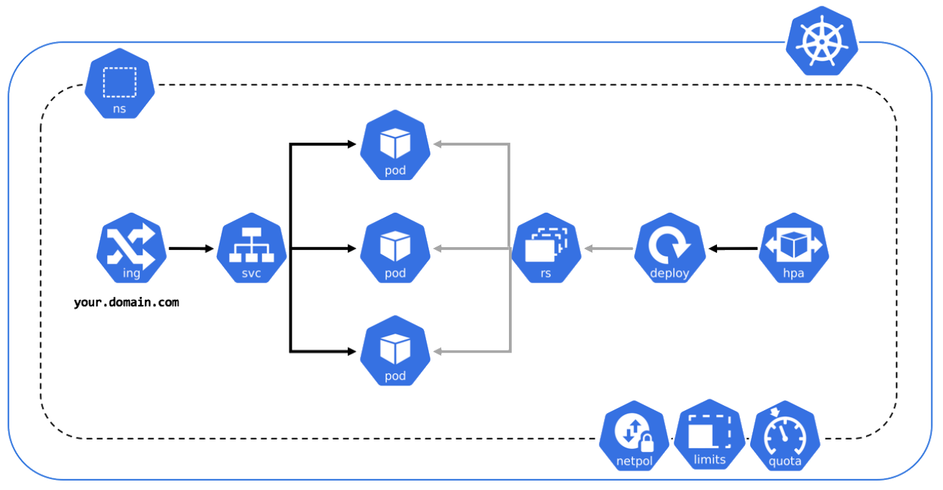

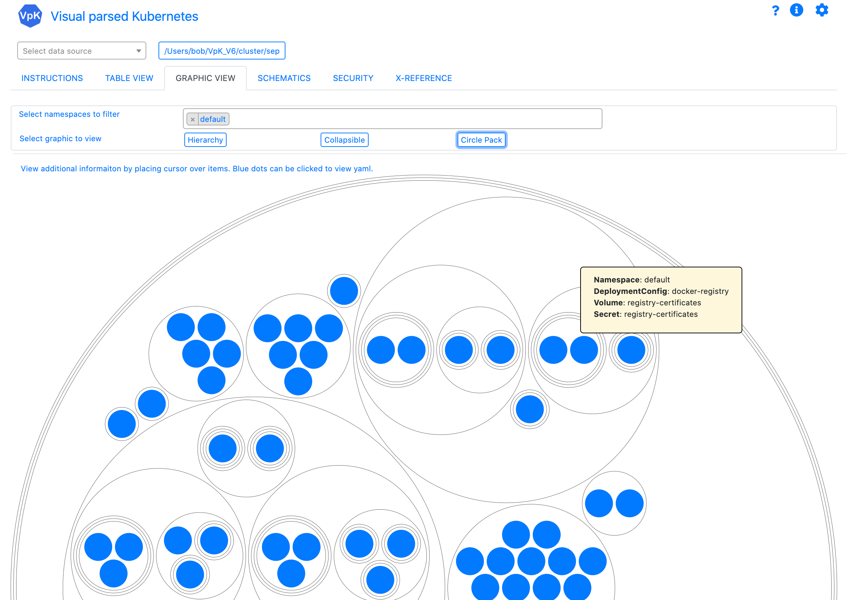
Overview
Visual parsed Kubernetes
Kubernetes
Application UI
Laptop

Slide 3
Overview
VpK is designed to capture a point-in-time snapshot of the cluster.
Vpk provides the ability to view the captured snapshot in a disconnected fashion. Once the snapshot is created the user no longer needs to be connected to the cluster.
Vpk will not modify a cluster. It is designed as read-only.
VpK is not a real time monitoring tool.

Slide 4
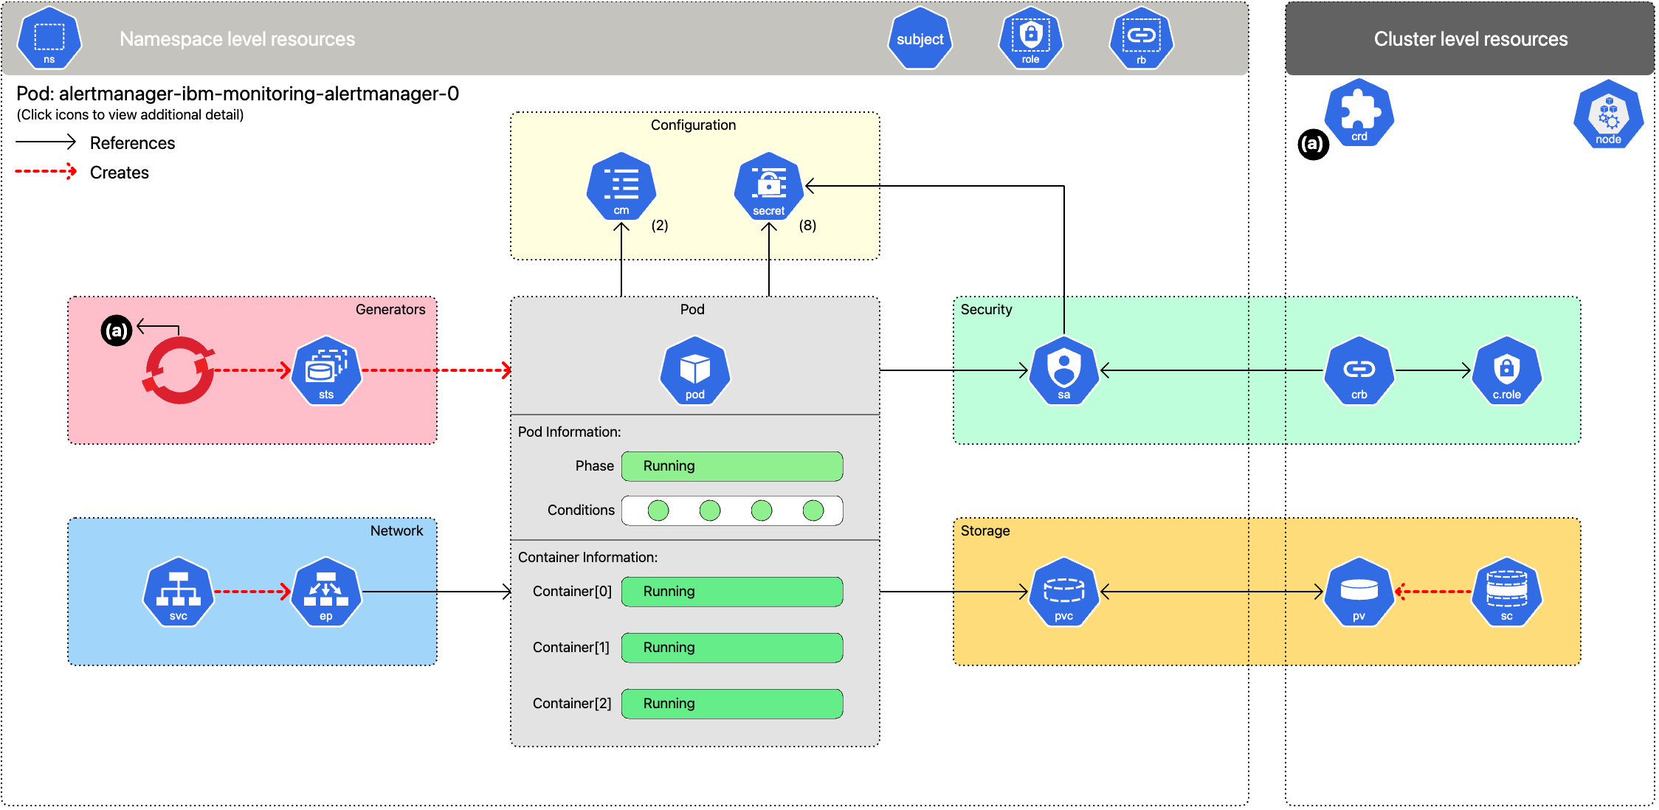
Interactive schematic of deployed workload

Slide 5
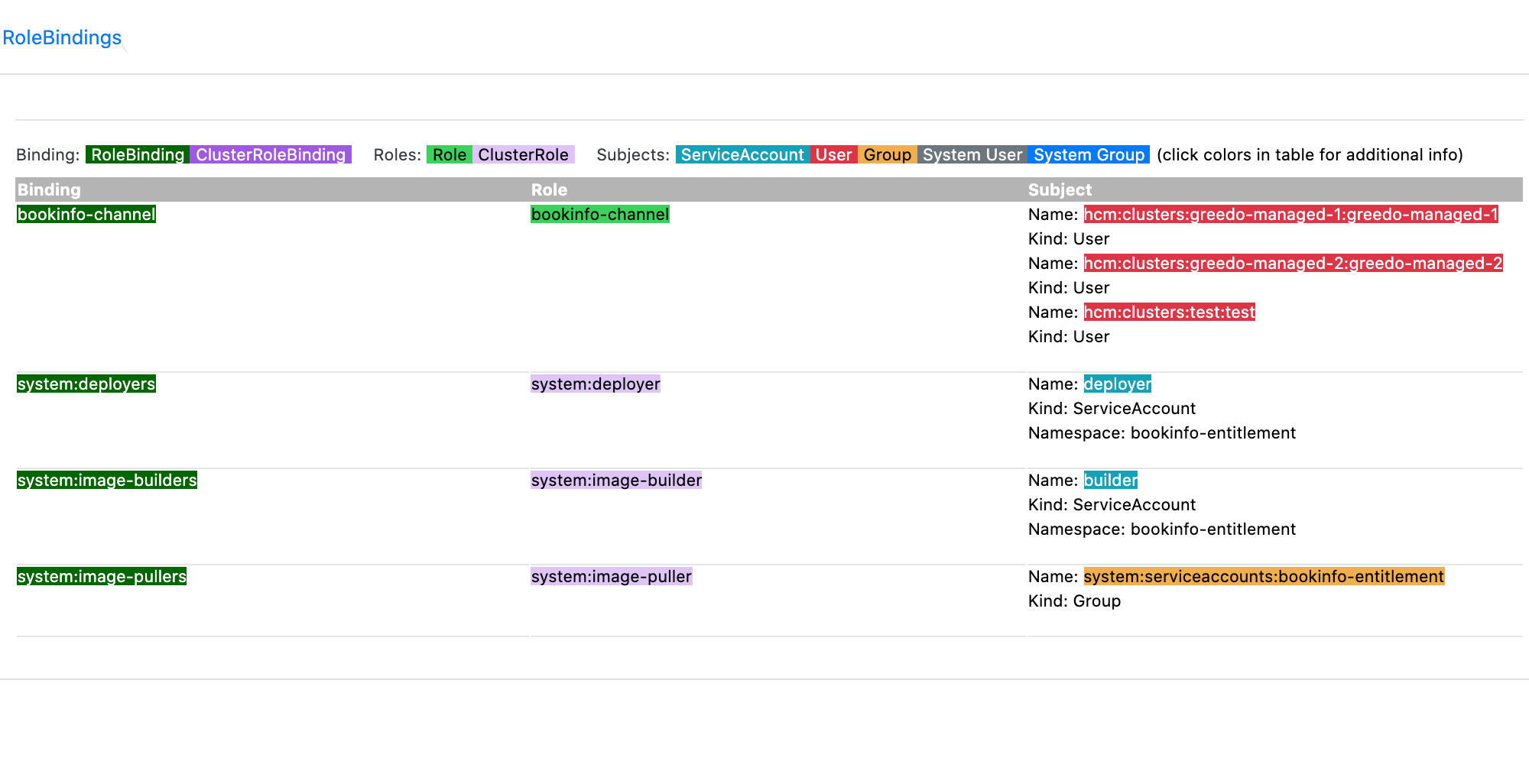
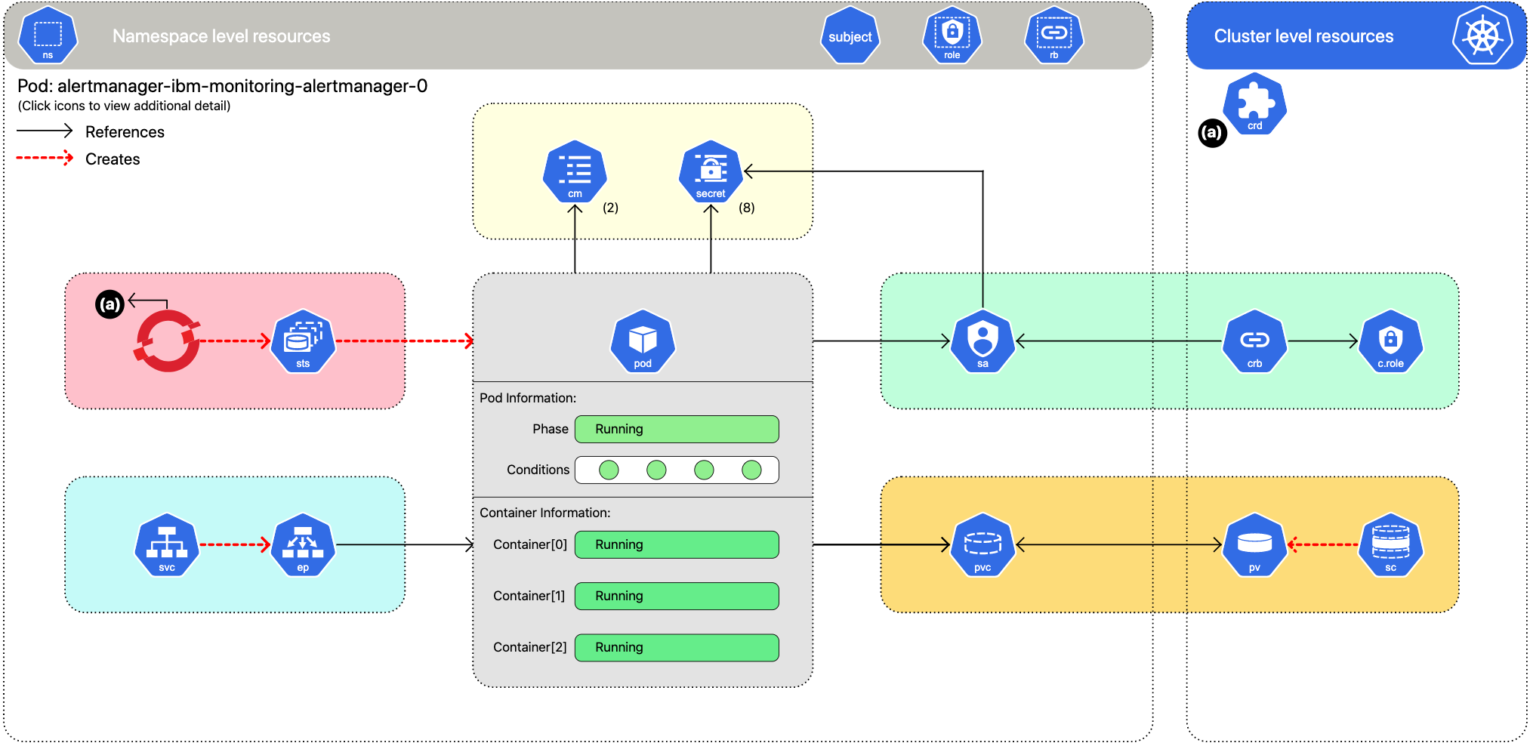
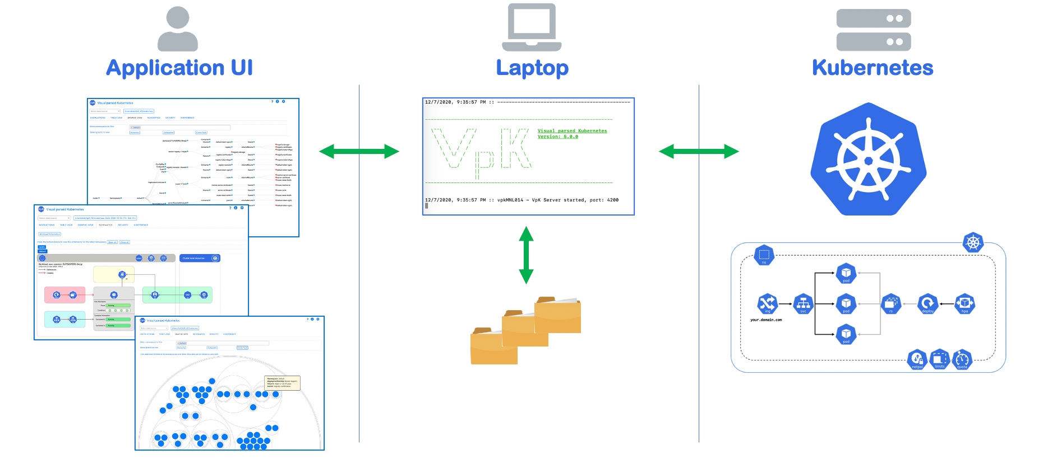
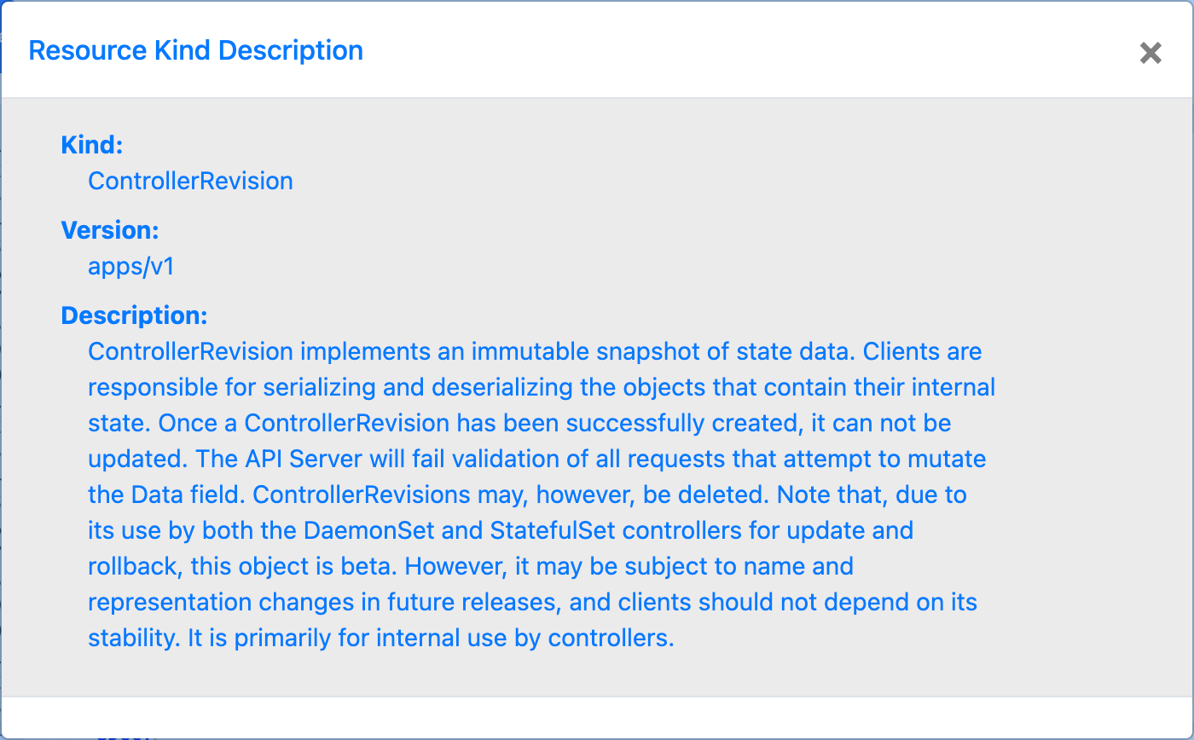
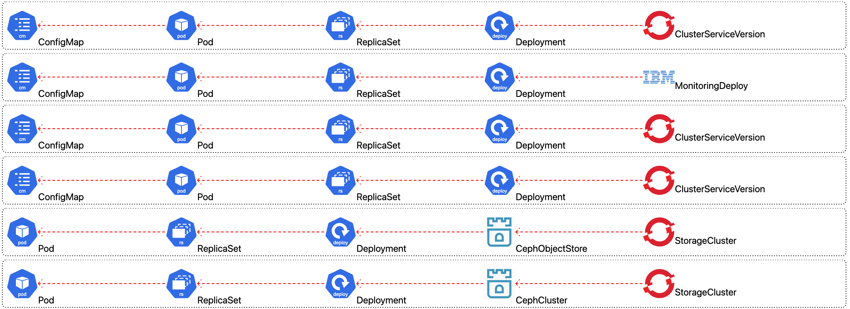
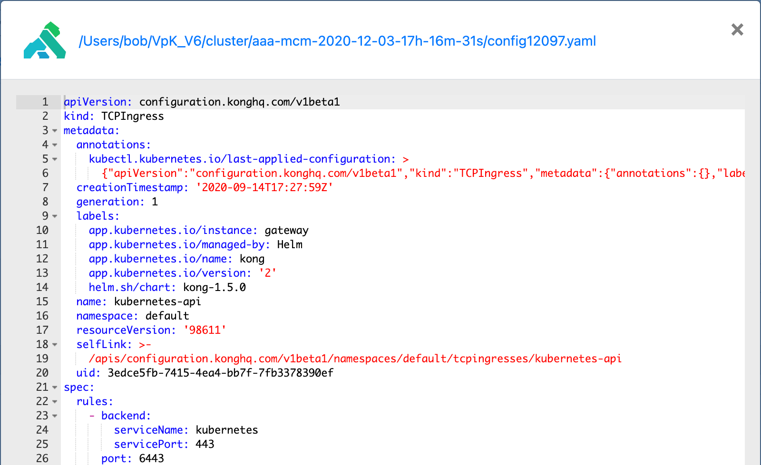
RBAC info, view yaml, ownerRefs, descriptions
OwnerReference chains
Resource description
Color coded views of RBAC
View resource yaml

Slide 6
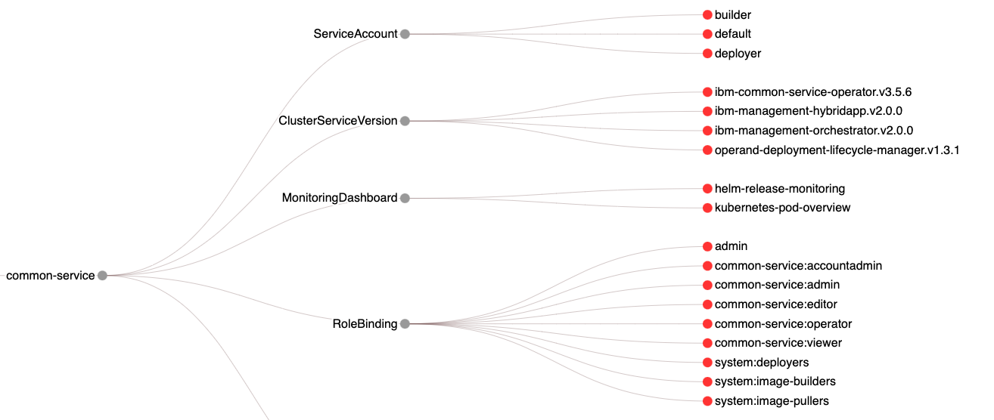
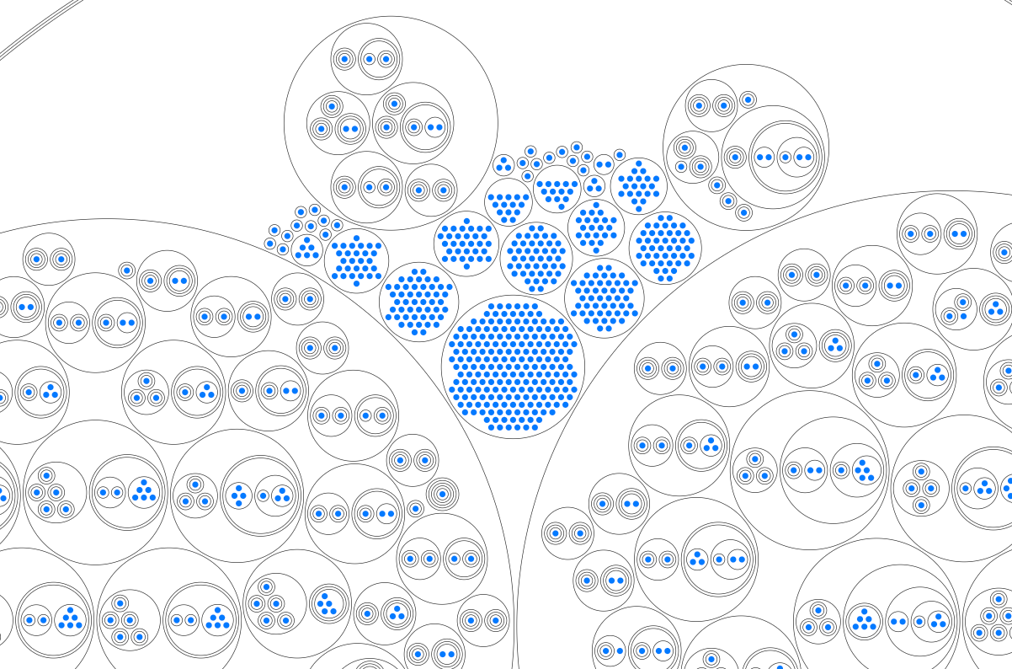
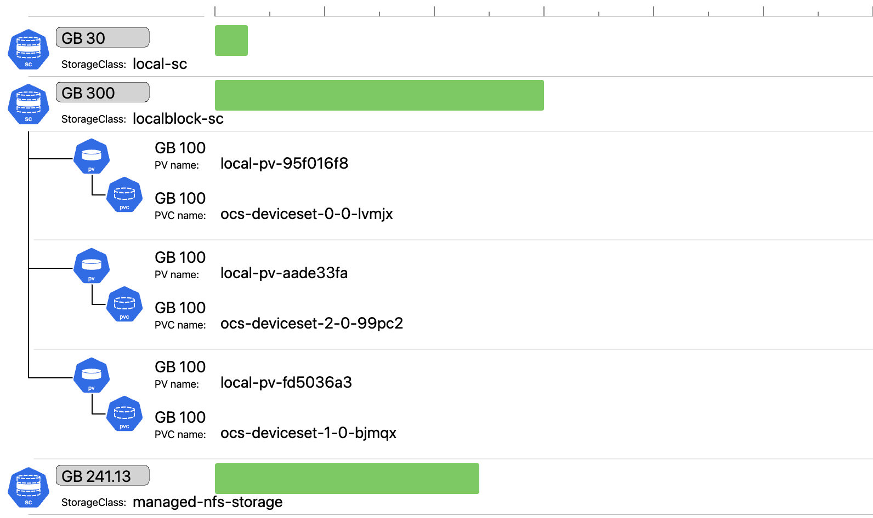
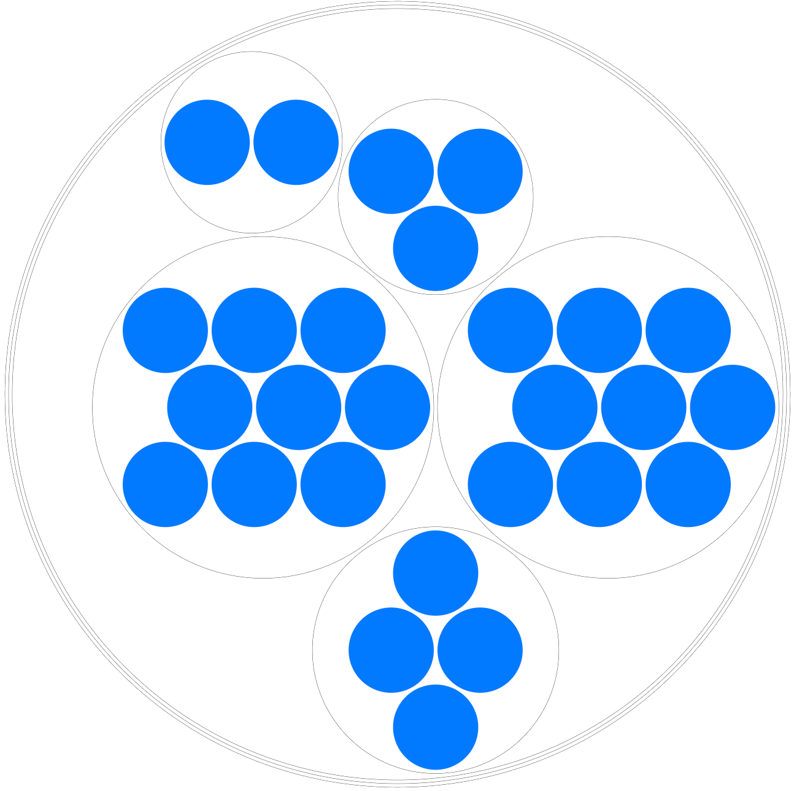
Multiple graphics of K8 resources
Hierarchy diagrams
CirclePack Diagrams
Drill-down
Bar charts

Slide 7
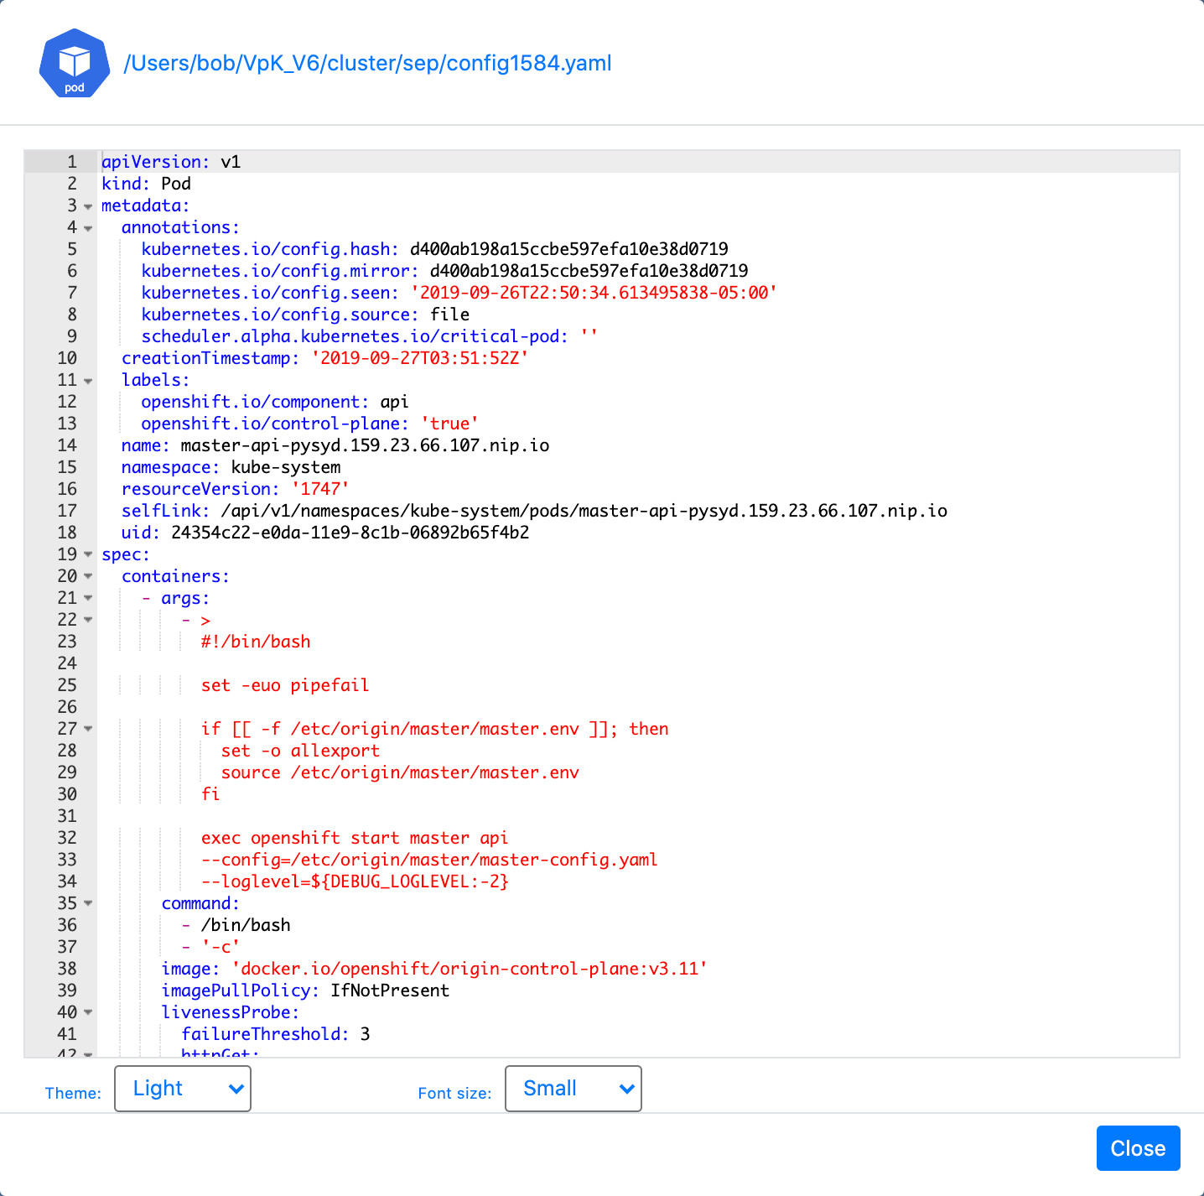
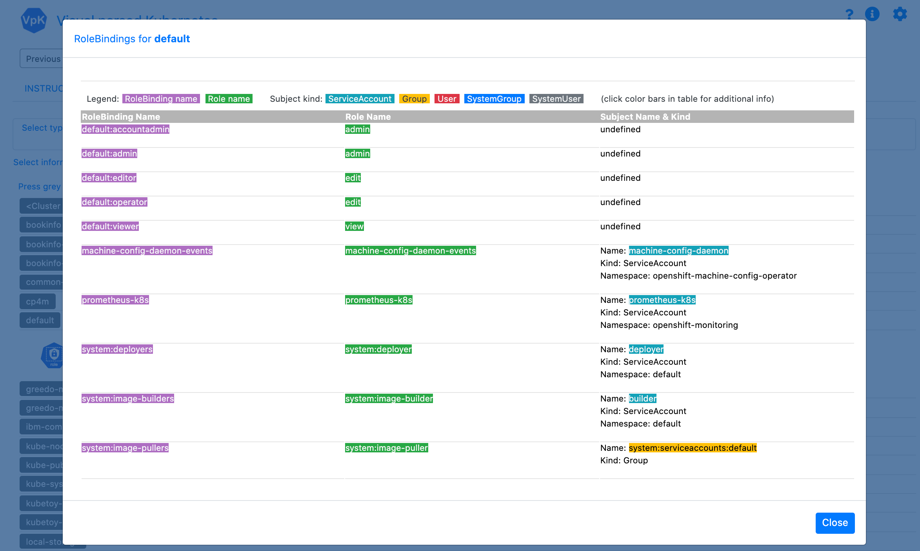
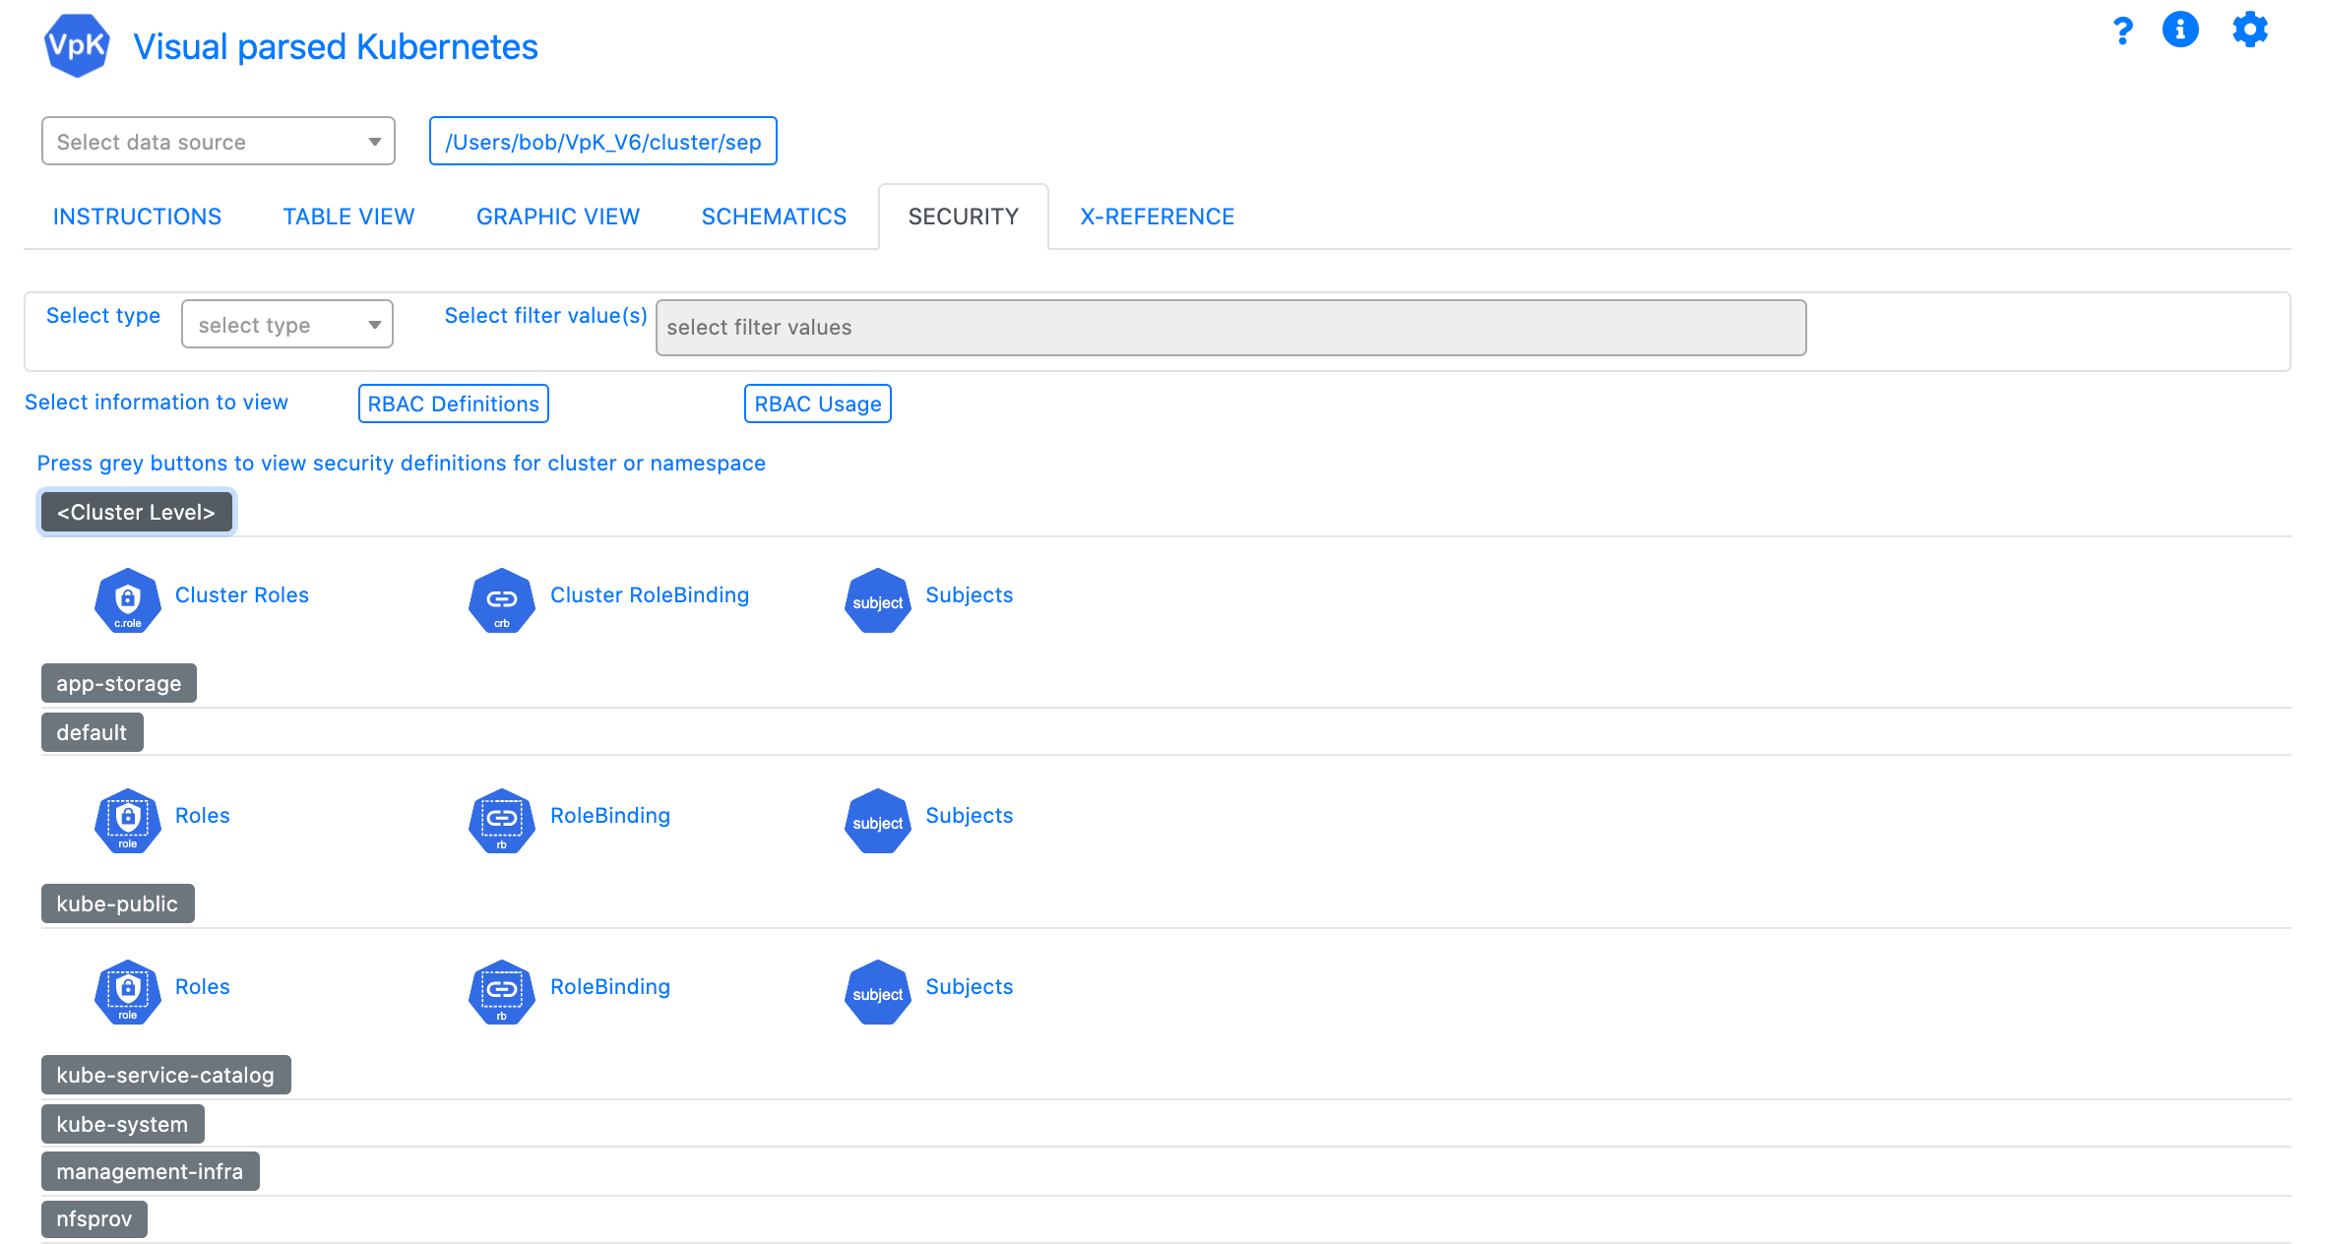
VpK Training
insert training topic

